Slide 1
Resume Classification
BY :
Rahul Mallareddi
Gayatri Kumari
Harshal Tumane
Viraj Balasaheb Yekhe
Uzair
Gunda Sanjay
Abhishek G H

Slide 2

Our Mentor
Snehal Shinde

Slide 3

Business Objective
Enhance the candidate experience by quickly routing resumes to the most appropriate hiring managers or departments, resulting in faster responses and more personalized communication.
Build the model to streamline the recruitment process by automatically categorizing resumes into predefined roles.

Slide 4
Data Science Methodology Flow Chart
Feedback
Business
Understanding
Deployment
Data
Extraction
Evaluation
Data
Understanding
Modeling
Data
Preparation

Slide 5






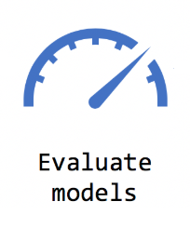


Architecture For Resume Classification
Resumes
Remove Short words
Remove NER Categories
Remove Stopwords
Lemmatization
Text Cleaning

Slide 6

Dataset
Category(Job Roles)
File Extension
Peoplesoft
React Developer
SQL Developer
Workday
PDF
TEXT
WORD

Slide 7
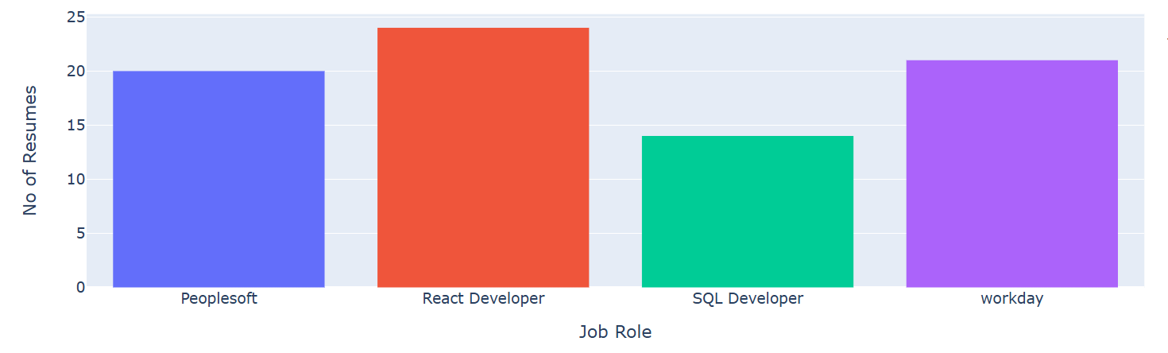
Visualization
No. of Resumes According to Job Roles
24
20
21
14

Slide 8
Text Cleaning
Text cleaning in natural language processing (NLP) is the process of preparing raw text data for NLP tasks by removing noise and inconsistencies.
It is an essential step in the NLP process because it helps improve the accuracy and reliability of results.
Source
text
Identity
Noise
Noise
Removal
Character
Normalization
Data
Masking
Clean
text
Data Cleaning

Slide 9
Lemmatization
Lemmatization is a natural language processing (NLP) technique used to reduce words to their base or root form, known as a lemma.
This process ensures that the resulting word is a valid dictionary word and aligns with the grammatical context.
For instance, lemmatization recognizes not only singular and plural forms but also changes based on tense, part of speech, and context, making it highly effective for text standardization
LEMMATIZATION
Drive
Drives
Lemmatize
Drive
Drove
Driven

Slide 10
Stop Words
a
l
the
In
Stop Words
Stop words are common words in a language that are often removed during text preprocessing in natural language processing (NLP).
These words, such as "is," "the," "and," or "in," occur frequently in text but usually do not contribute significant meaning to the overall content. By removing stop words, text analysis becomes more focused on meaningful and relevant terms.
of
for
at
to
on
with
from

Slide 11
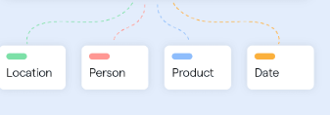
Named Entity Recognition (NER)
The remove_NER_categories function utilizes the spaCy library to process text by identifying and removing specific named entities, such as names, organizations, locations, and dates, using Named Entity Recognition (NER).
Example
John McCarthy who Was born September 4, 1927 was an American computer scientist and cognitive scientist. He was one of the founders of the discipline of artificial intelligence. He co-authored the document that coined the term “Artificial intelligence’’(AI), developed the programming language family Lisp, significantly influenced the design of the language.

Slide 12
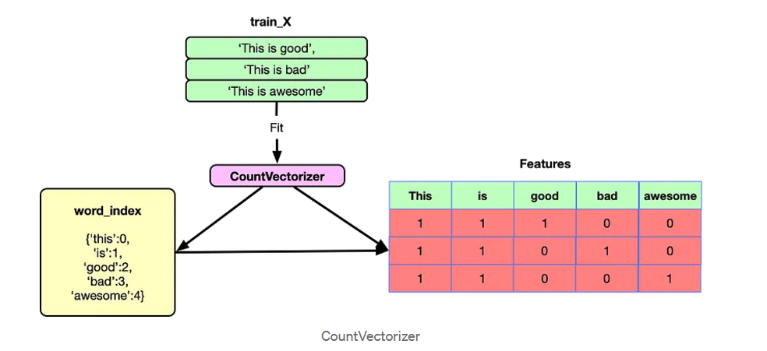
TF-IDF (Term Frequency-Inverse Document Frequency) Matrix
TF-IDF (Term Frequency-Inverse Document Frequency) Matrix is a numerical representation of text data that reflects the importance of words in a document relative to a collection of documents (corpus).
TF-IDF code initializes a TF-IDF Vectorizer, fits it to cleaned resume text data, and converts the resulting TF-IDF matrix into a Data Frame with job roles.
The resulting TF-IDF matrix is widely used in text mining, information retrieval, and machine learning tasks like document classification and clustering.

Slide 13
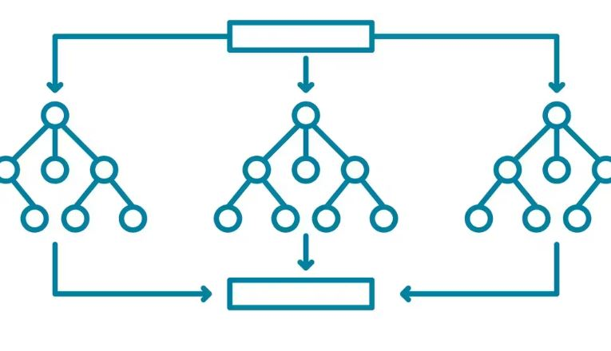
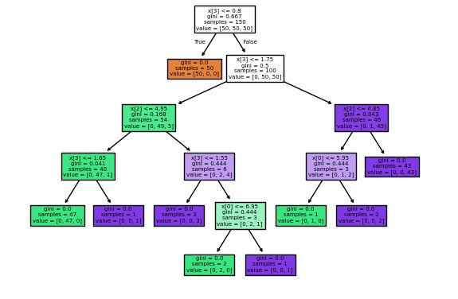
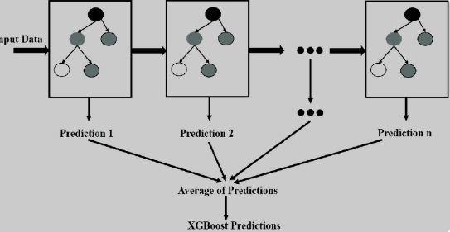
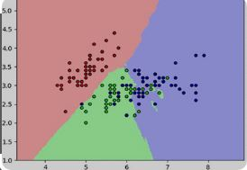
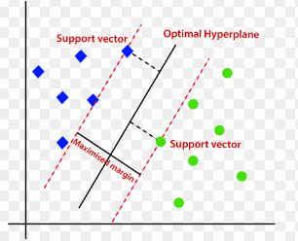
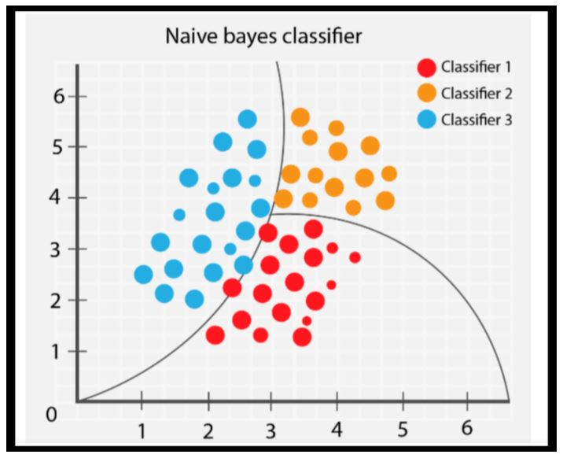
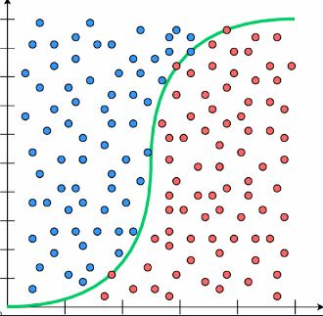
Models
Random Forest
Decision Tree
XG Boost
K-Nearest Neighbors
Support Vector Machine
Naïve Bayes
Logistic Regression

Slide 14
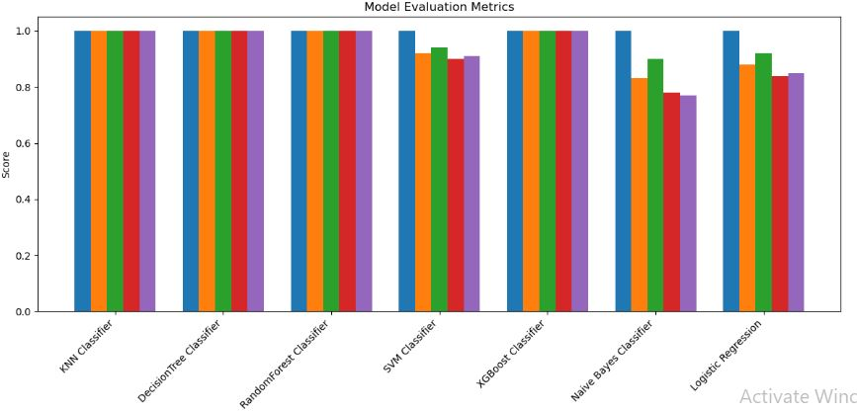

Model Evaluation
Train Accuracy
Test Accuracy
Precision
Recall
F-1- Score
Models | Train Accuracy | Test Accuracy
Random Forest | 1.0 | 1.0
Decision Tree | 1.0 | 1.0
KNN | 1.0 | 1.0
XG Boost | 1.0 | 1.0
Naïve Bayes | 1.0 | 0.83
SVM | 1.0 | 0.92
Logistic Regression | 1.0 | 0.88

Slide 15
Finalised Model : Random Forest
The Random Forest Classifier is the best choice for resume classification due to its:
High Accuracy: It performs perfectly on both training and test data.
Well-rounded Performance: Achieves top scores in precision, recall, and F1-score, ensuring accurate classifications.
Robust and Reliable: It reduces errors and handles various types of resumes effectively in real-world applications.
Classification Report Random Forest on Test Data
 | Precision | Recall | F1-Score | Support
Peoplesoft | 1.00 | 1.00 | 1.00 | 7
React Developer | 1.00 | 1.00 | 1.00 | 7
SQL Developer | 1.00 | 1.00 | 1.00 | 4
Workday | 1.00 | 1.00 | 1.00 | 6
Accuracy |  |  | 1.00 | 24
Macro avg. | 1.00 | 1.00 | 1.00 | 24
Weighted avg. | 1.00 | 1.00 | 1.00 | 24
Accuracy Score
Train | 1.0
Test | 1.0

Slide 16

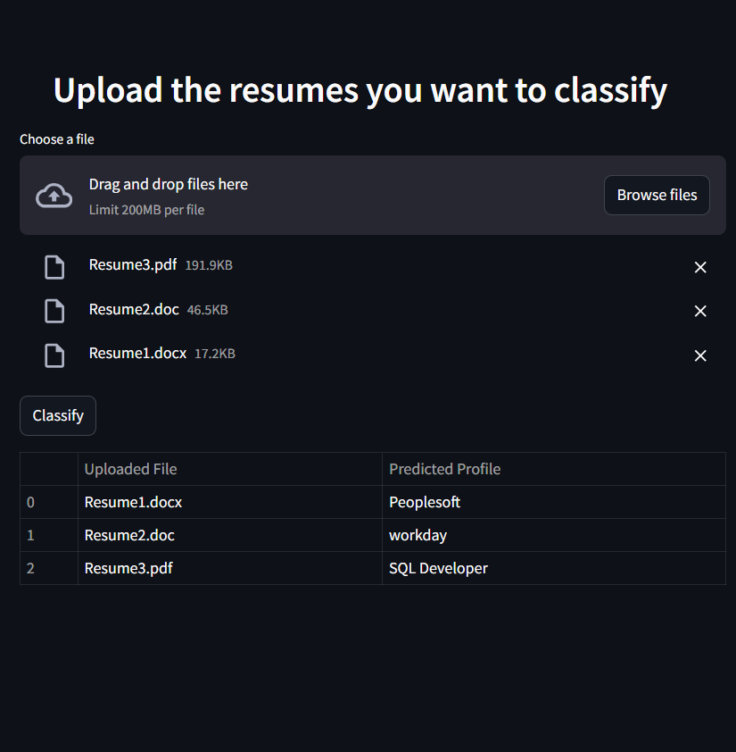
Deployment
By using the Streamlit framework, we have deployed the Random Forest Classifier model and created a web page, So that we can upload multiple resumes with different extensions at a time to get classification efficiently.

Slide 17
Challenges Faced and Their Solutions
Extracting the data from a file is a cruicial thing.The ‘textract’ method was incompatible for extracting the data from the files with different extensions, also it is deprecated now.
Solution:
To overcome the incompatibility with ‘textract’, we have discovered the new ‘tika’ method, which parses the data from the files with different extensions. It runs on Java server.
Necessary packages with the different versions on the different systems was a hurdle.
Solution:
It is resolved by keeping the same versions of all the packages in all the systems. E.g. NumPy==1.26.4
Model works well if the data is clean and well preprocessed. Cleaning the raw data is a difficult thing.
Solution:
Hence, various cleaning methods performed. E.g. Removing Links, Multispaces, bullets, 2 letters words, locations, etc.
Extraction of the Data
Package versions
Cleaning of the
extracted data

Slide 18


Thank You

